Slide 1
A USER INTRODUCTION
KATHLEEN DURKIN
DIRECTOR, MR PLATFORM ADMINISTRATION

Slide 2
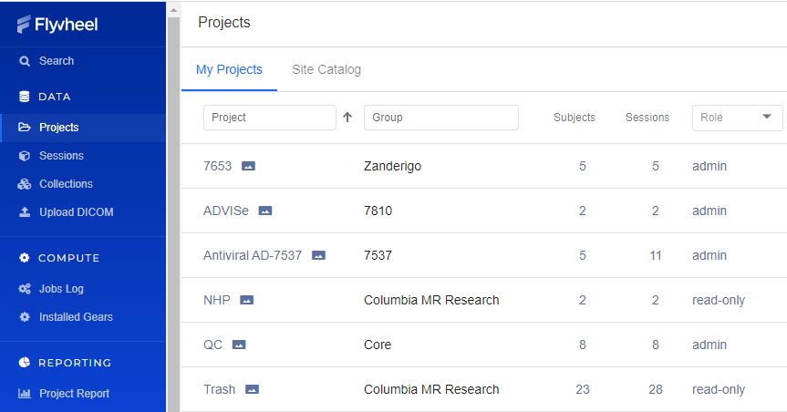
WHAT IS FLYWHEEL?
-https://cmrrc.zi.columbia.edu
-MR data storage system similar to a PACS
-MR data preprocessing and processing
-MR data sharing with collaborators
Notes:
Flywheel is a web-based system for data management, and more.
All MR data generated at the Zuckerman MR Platform are automatically uploaded to Flywheel.
Flywheel stores data similar to a PACS (Picture Archive Communication System) system in a radiology department.
But Flywheel ALSO has tools for preprocessing and processing data.
With our help, you can share data with collaborators.

Slide 3
Get started
To get started right in Flywheel you need to have:
A UNI
A PI
A study that you need access to
Contact Jonathan Cardona (jc5724@columbia.edu) to
set you up in Flywheel as a user.
Let him know what group you work for (your lab) and
what project you are working on.

Slide 4
Link to Access Flywheel
https://cmrrc.zi.columbia.edu
https://cmrrc.zi.columbia.edu
Notes:
https://cmrrc.zi.columbia.edu

Slide 5
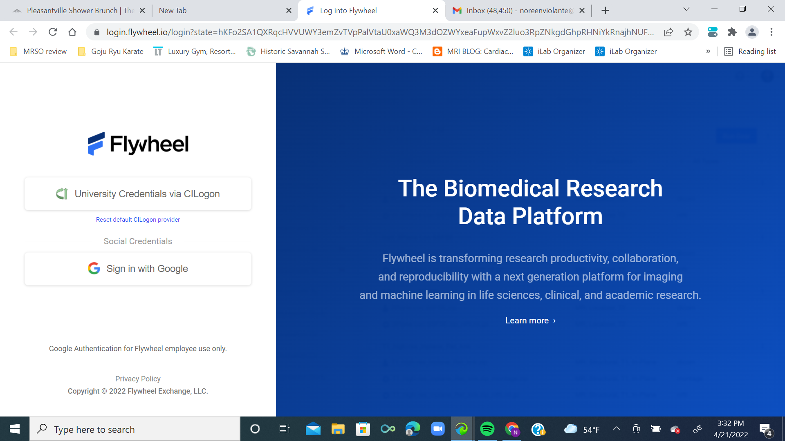
Notes:
Click the “University Credentials via CILogin” button

Slide 6
USER, GROUPS, PROJECTS, SESSIONS
A User is any individual that can access data on Flywheel
The MR Technologist must create a new user profile for you before you can begin to use Flywheel.

Slide 7
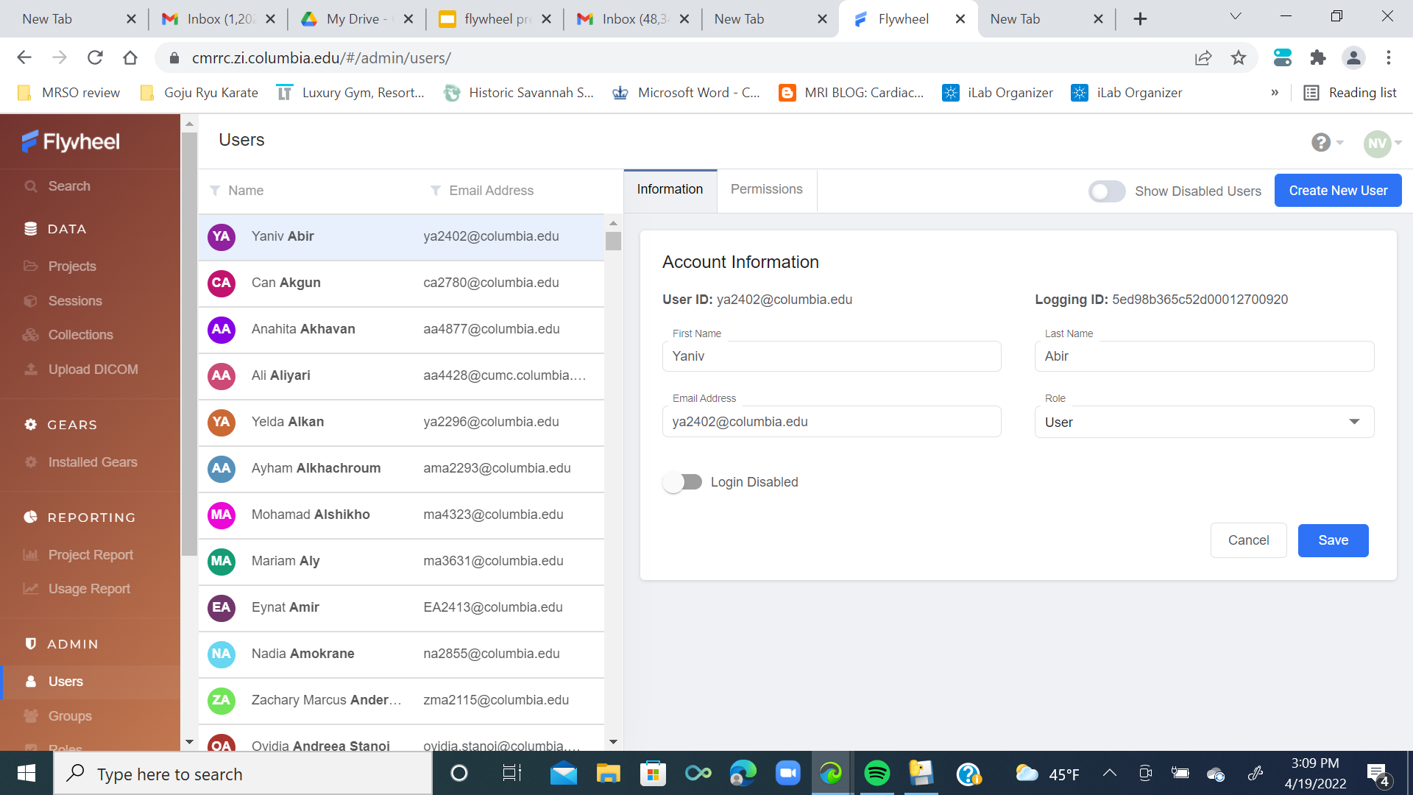
Notes:
Here are some users.

Slide 8
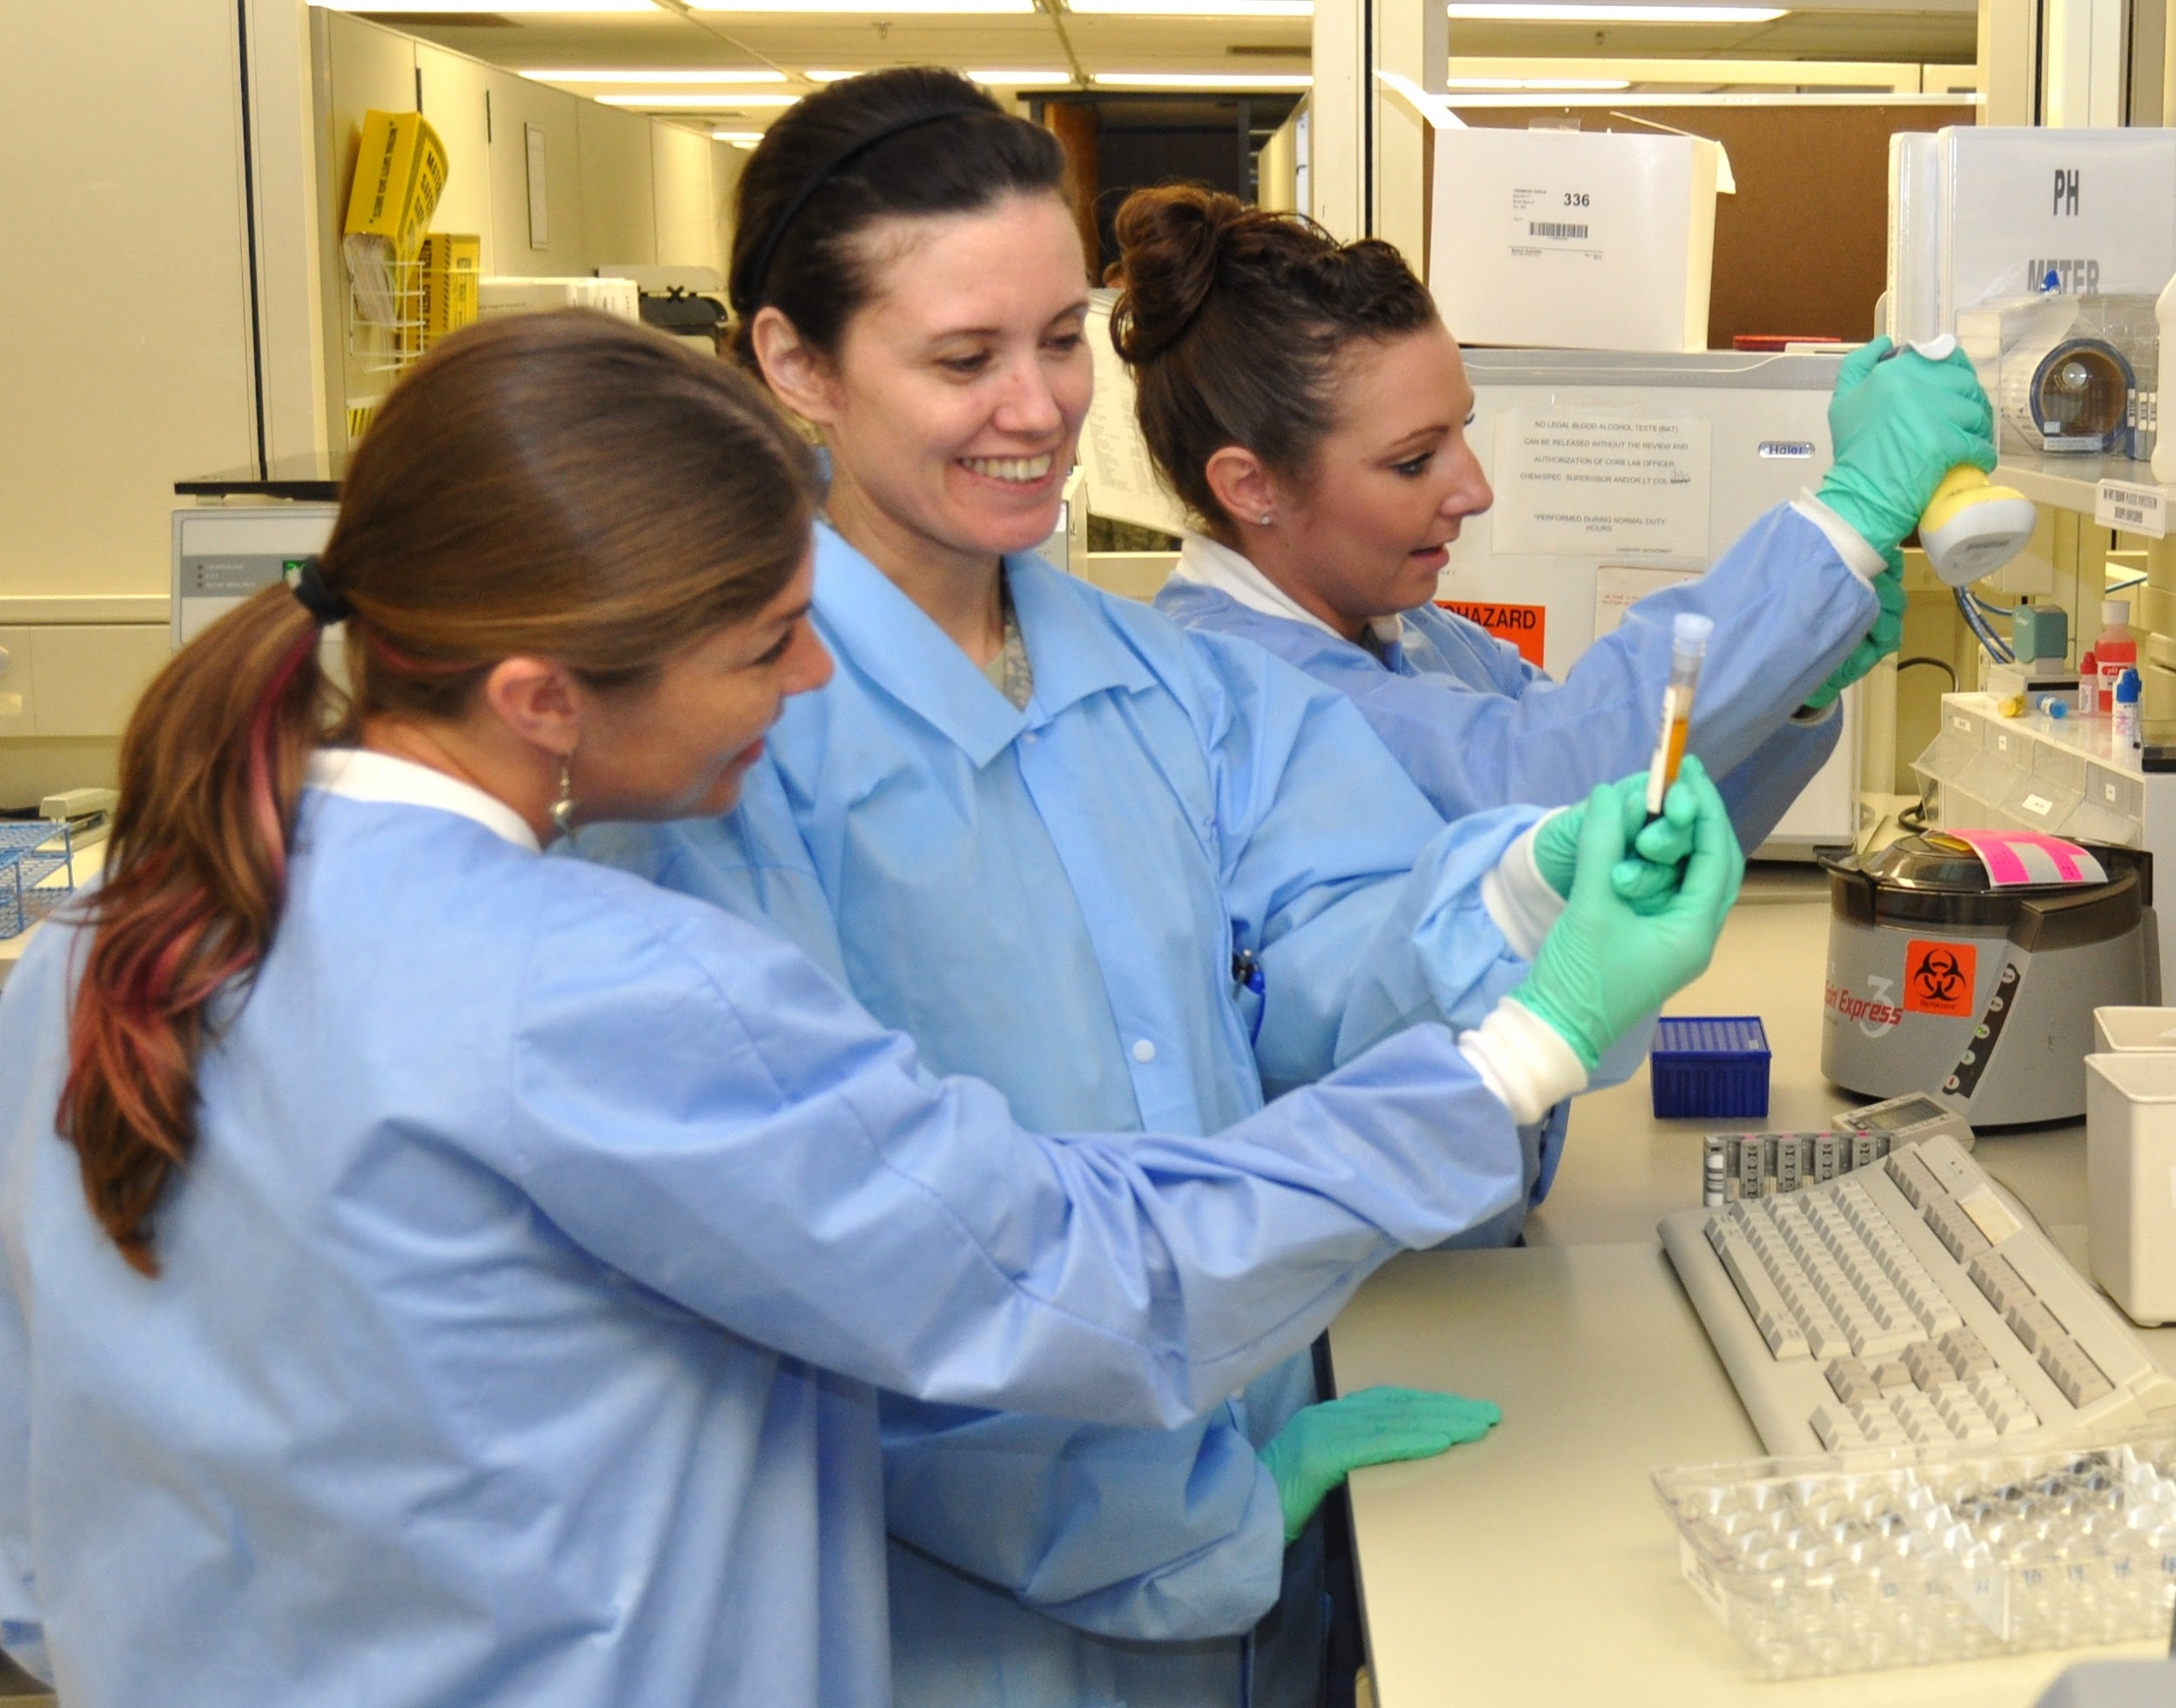
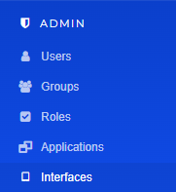
USER, GROUPS, PROJECTS, SESSIONS
A Group is the name give to the lab in which you work, usually named after the PI.
Sternlab
Brickman
Horga

Slide 9
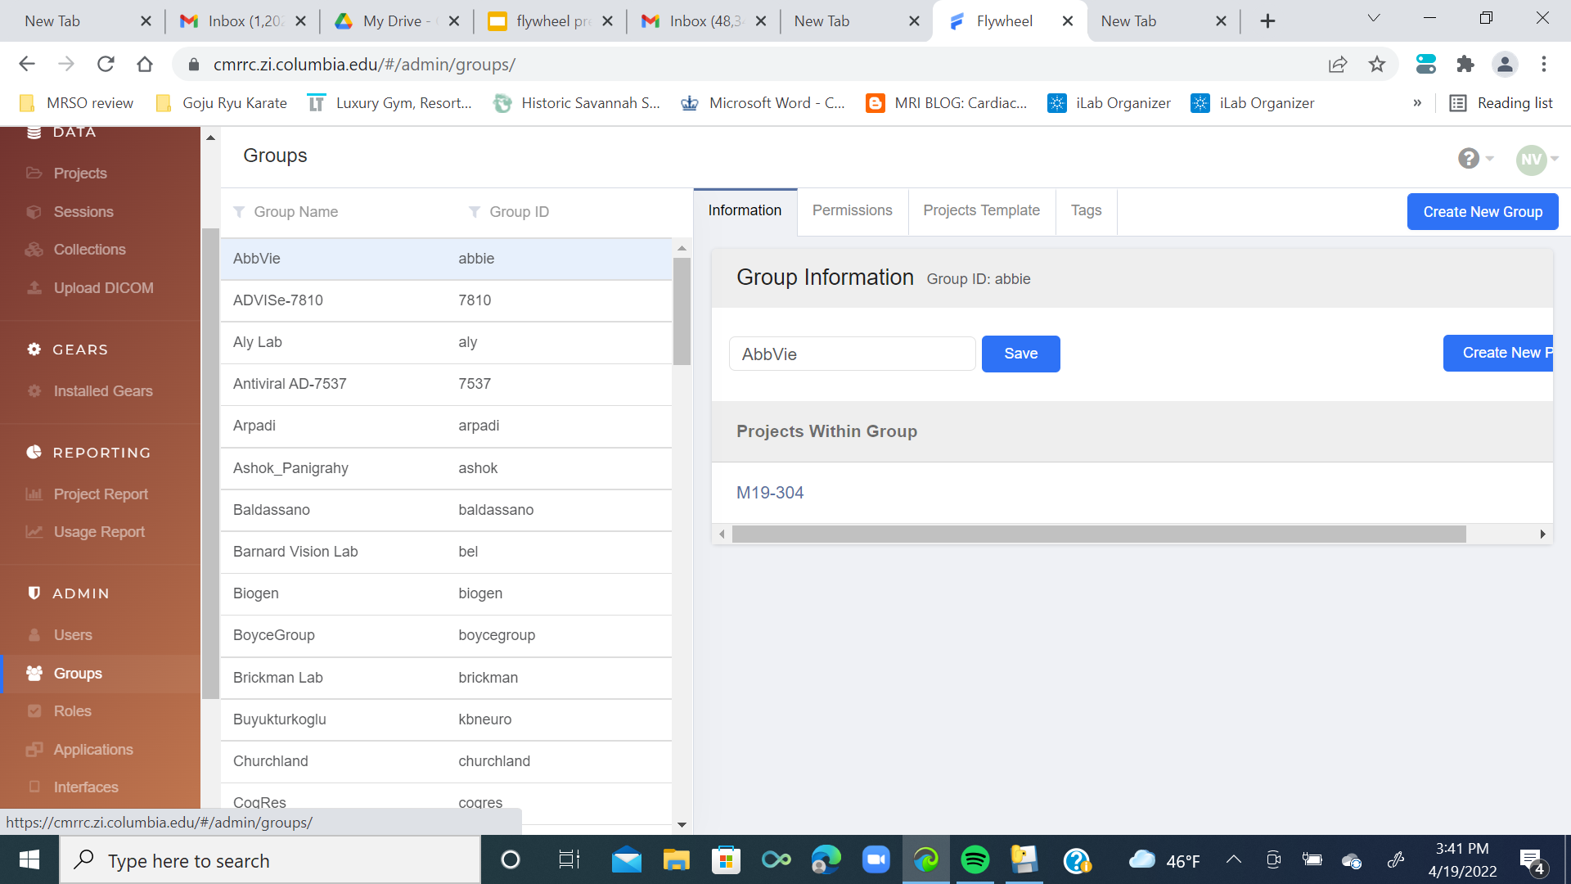
Projects within this group
Notes:
Here are some groups.

Slide 10
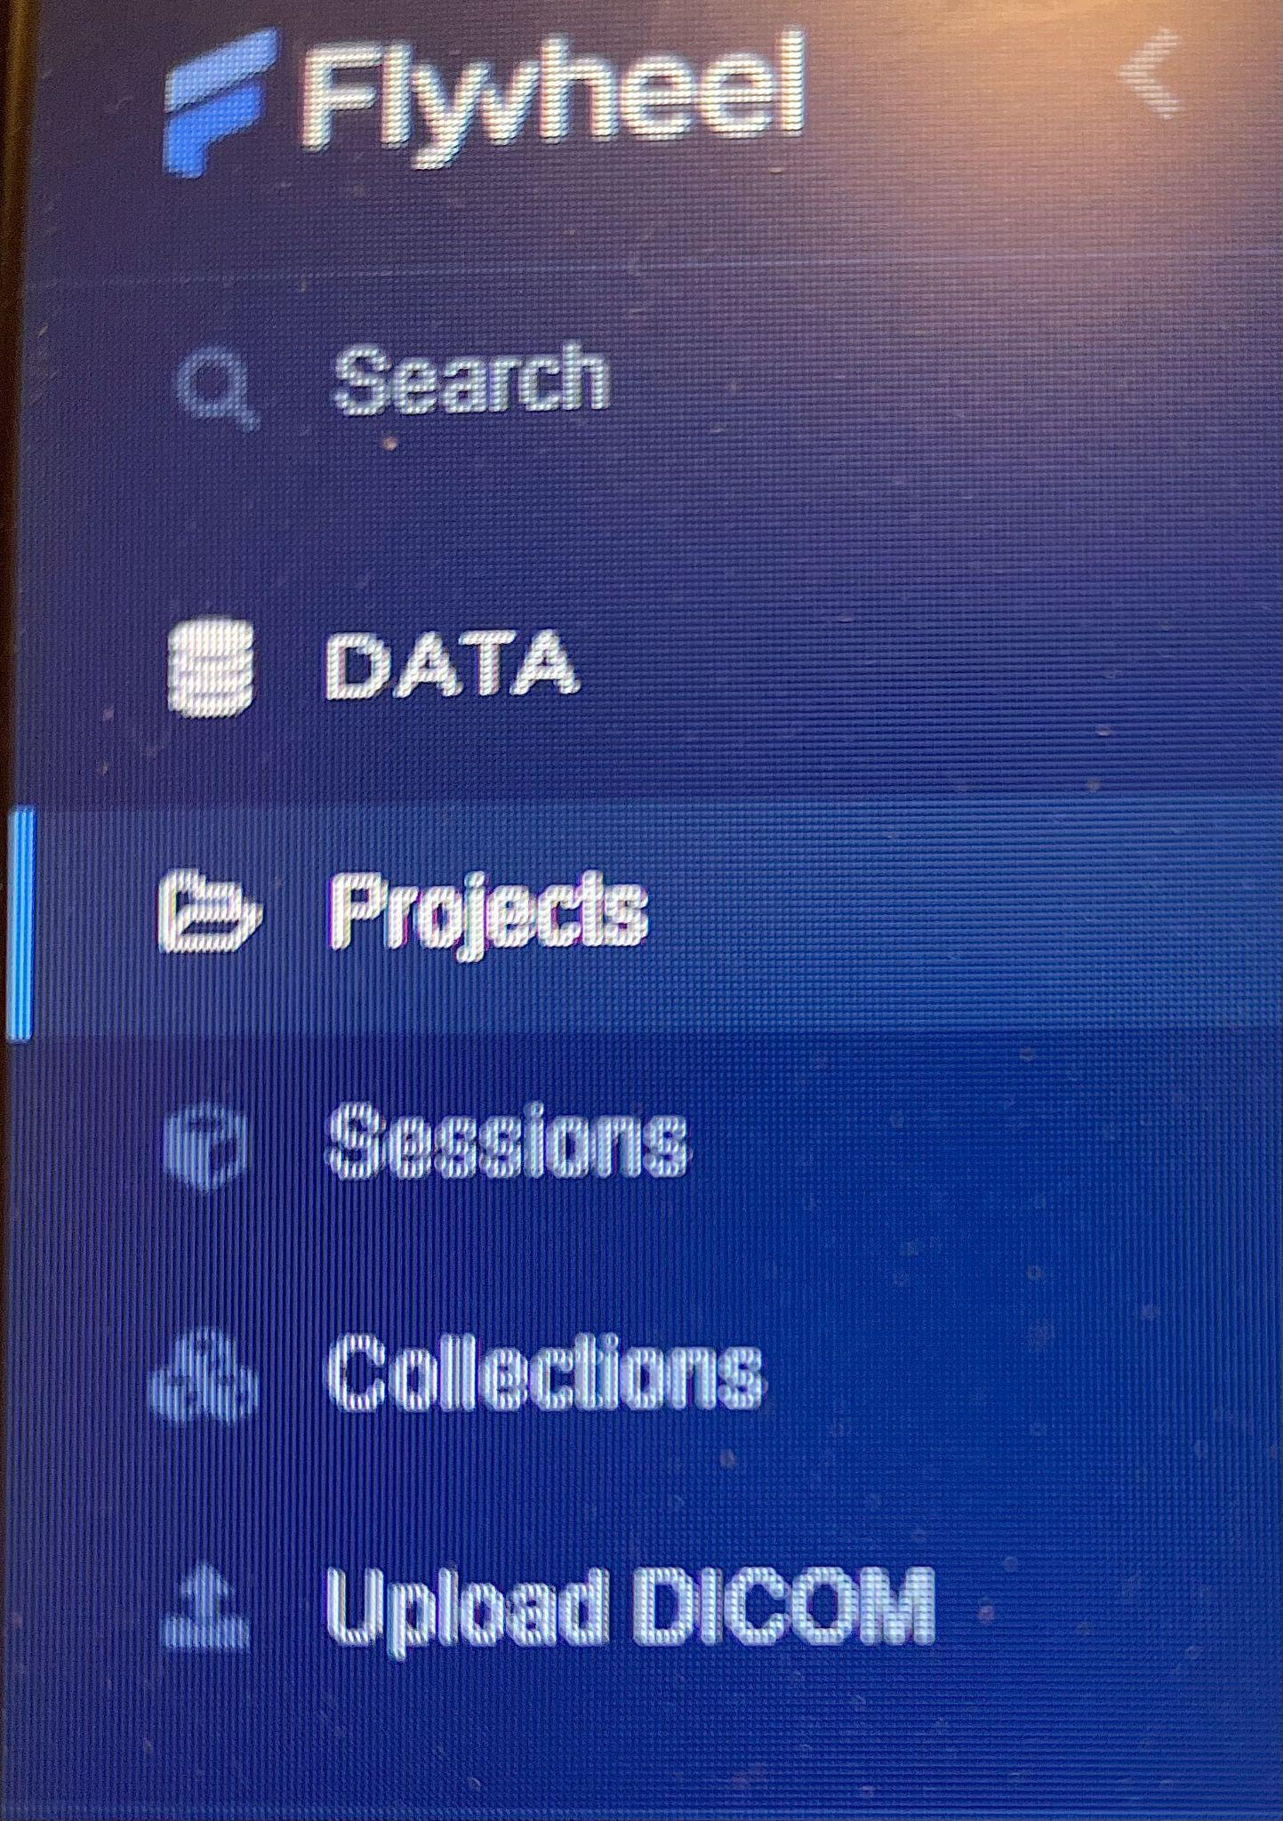
USER, GROUPS, PROJECTS, SESSIONS
A Project is a particular IRB- approved study that your group is working on.
Offspring
Scaffold
KEEPS
Notes:
Usually named with a term or acronym related to the study, but sometimes labeled with the sponsor name or IRB number.

Slide 11
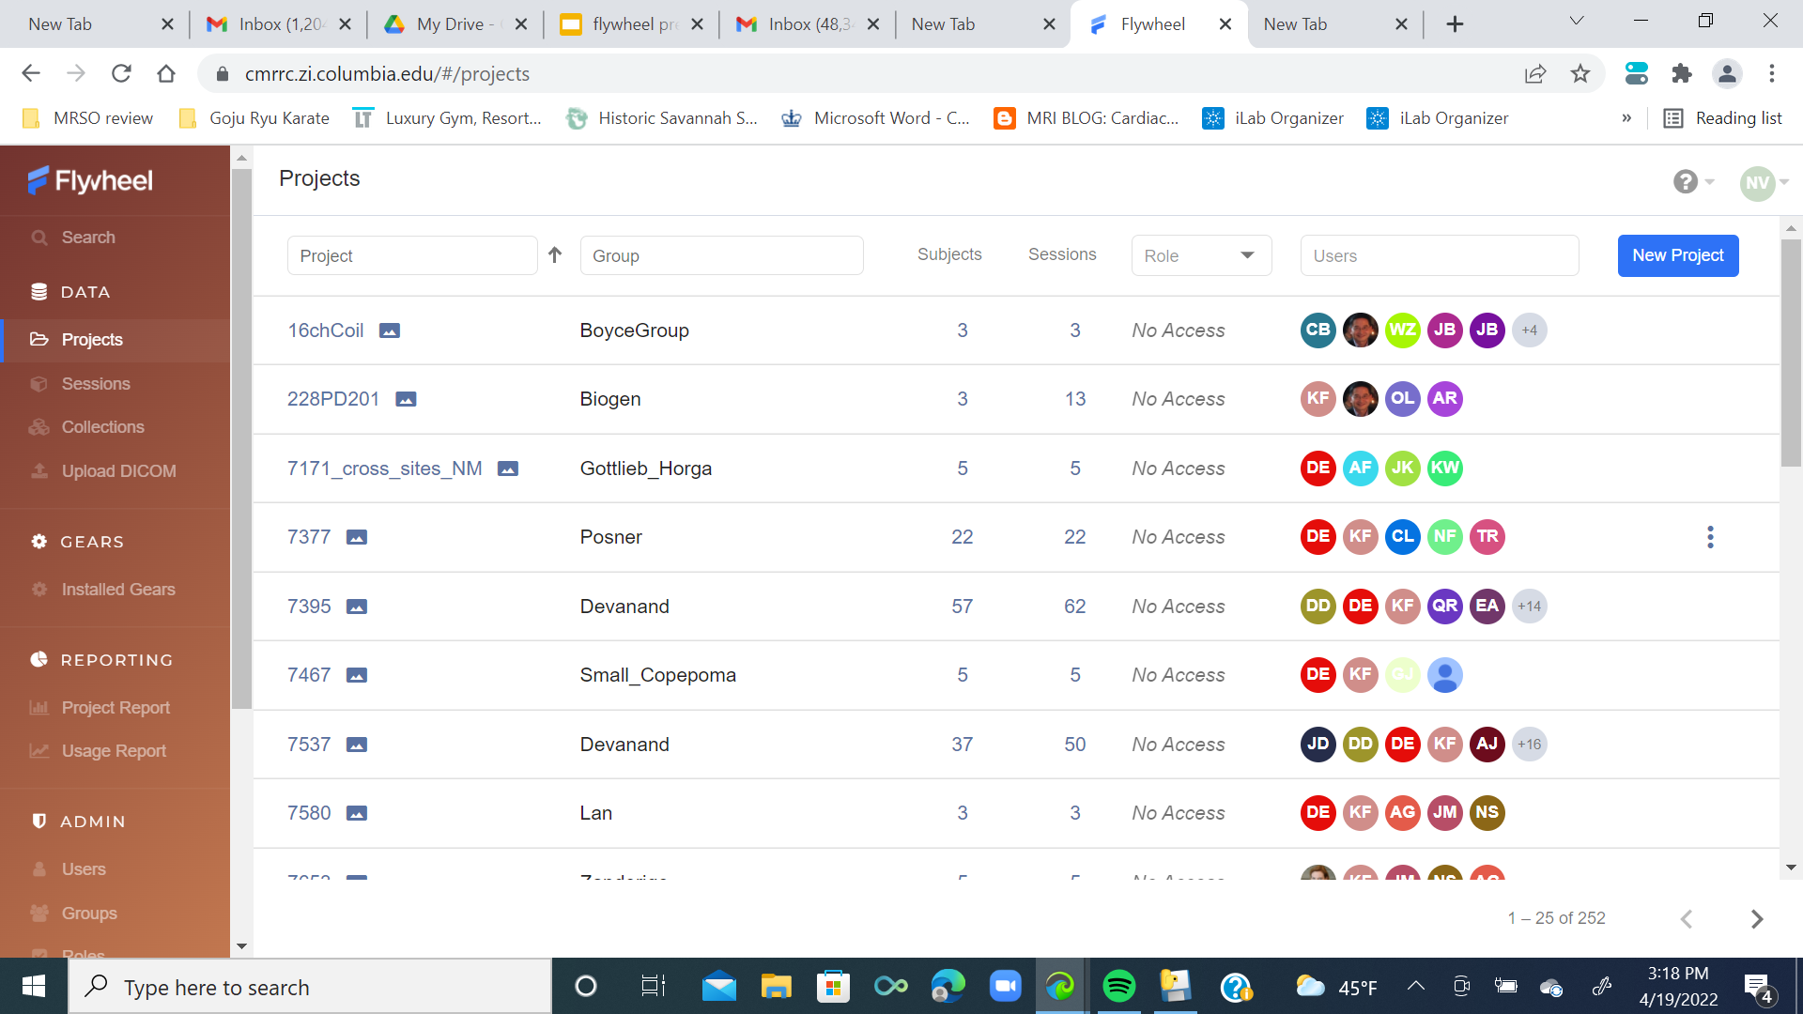
Notes:
Here are some projects.

Slide 12
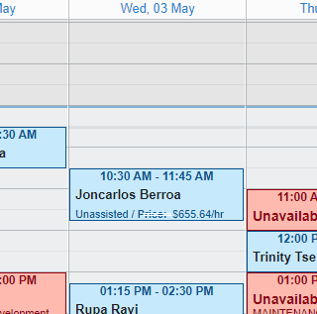
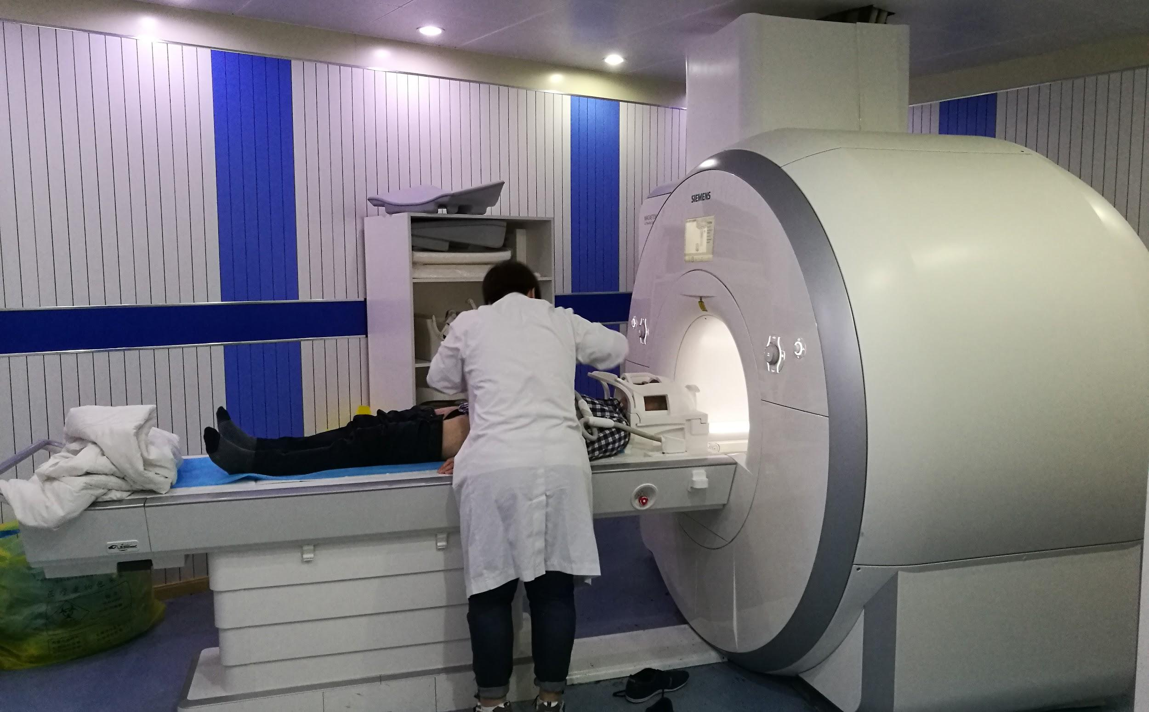
USER, GROUPS, PROJECTS, SESSIONS
A Session is a block of time that you or a member of your group used the MRI at ZI to acquire images/data which you reserved in iLab.
Notes:
The session is the individual scan. It is time-stamped and date-stamped, and labeled with the subject ID.

Slide 13
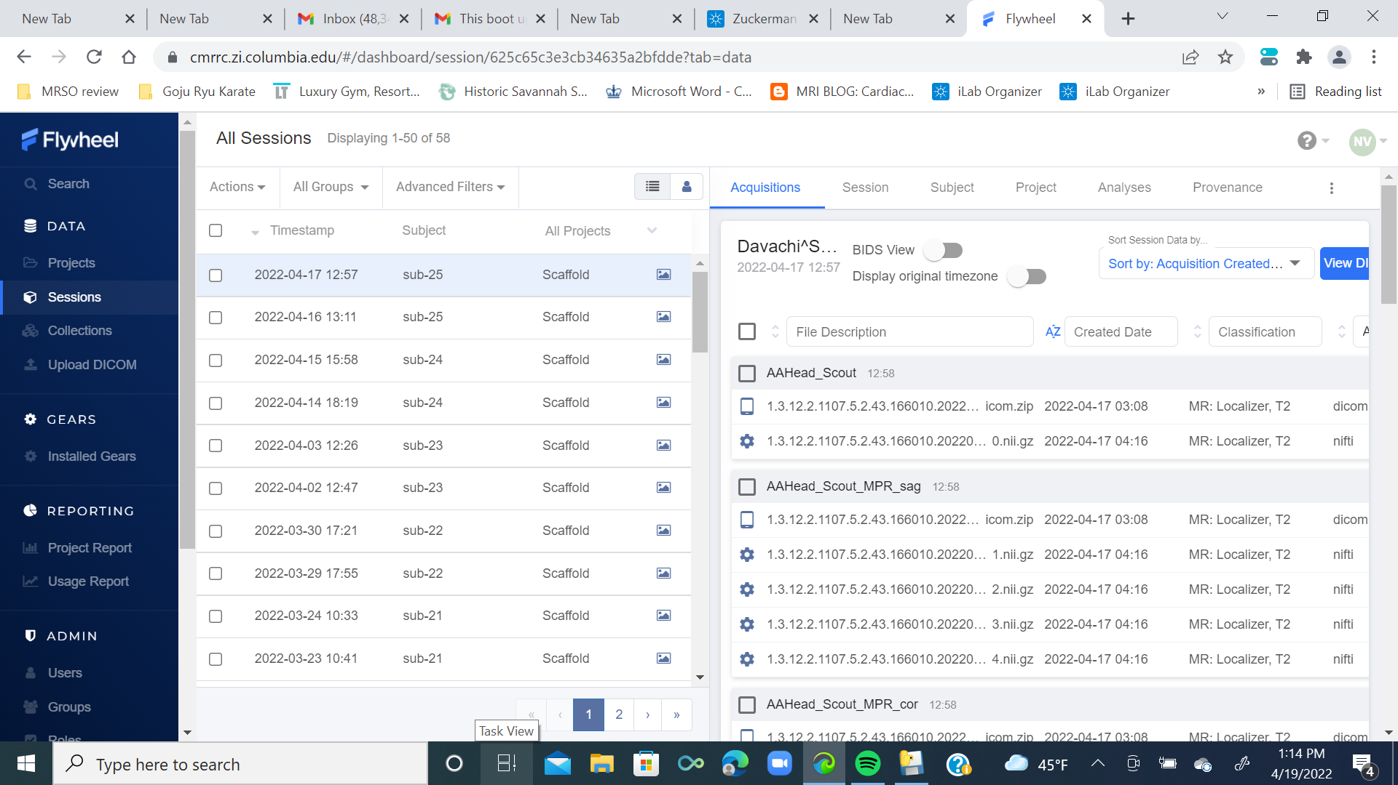
Notes:
Here are some sessions.

Slide 14
Session
1
Project
2
Group
3
Notes:
Every session (or scan) is part of a project (or study) which belongs to a group (a PI’s lab).

Slide 15
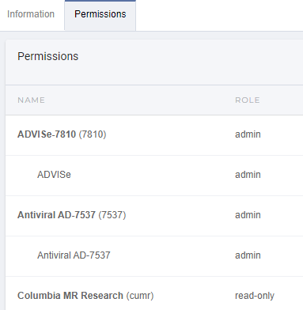
PERMISSIONS
You are only allowed to view or work with data if your PI gives you permission to do so.
Permission to access data from groups and projects is given by administration.
Notes:
Here are some of Kathleen’s permissions.

Slide 16
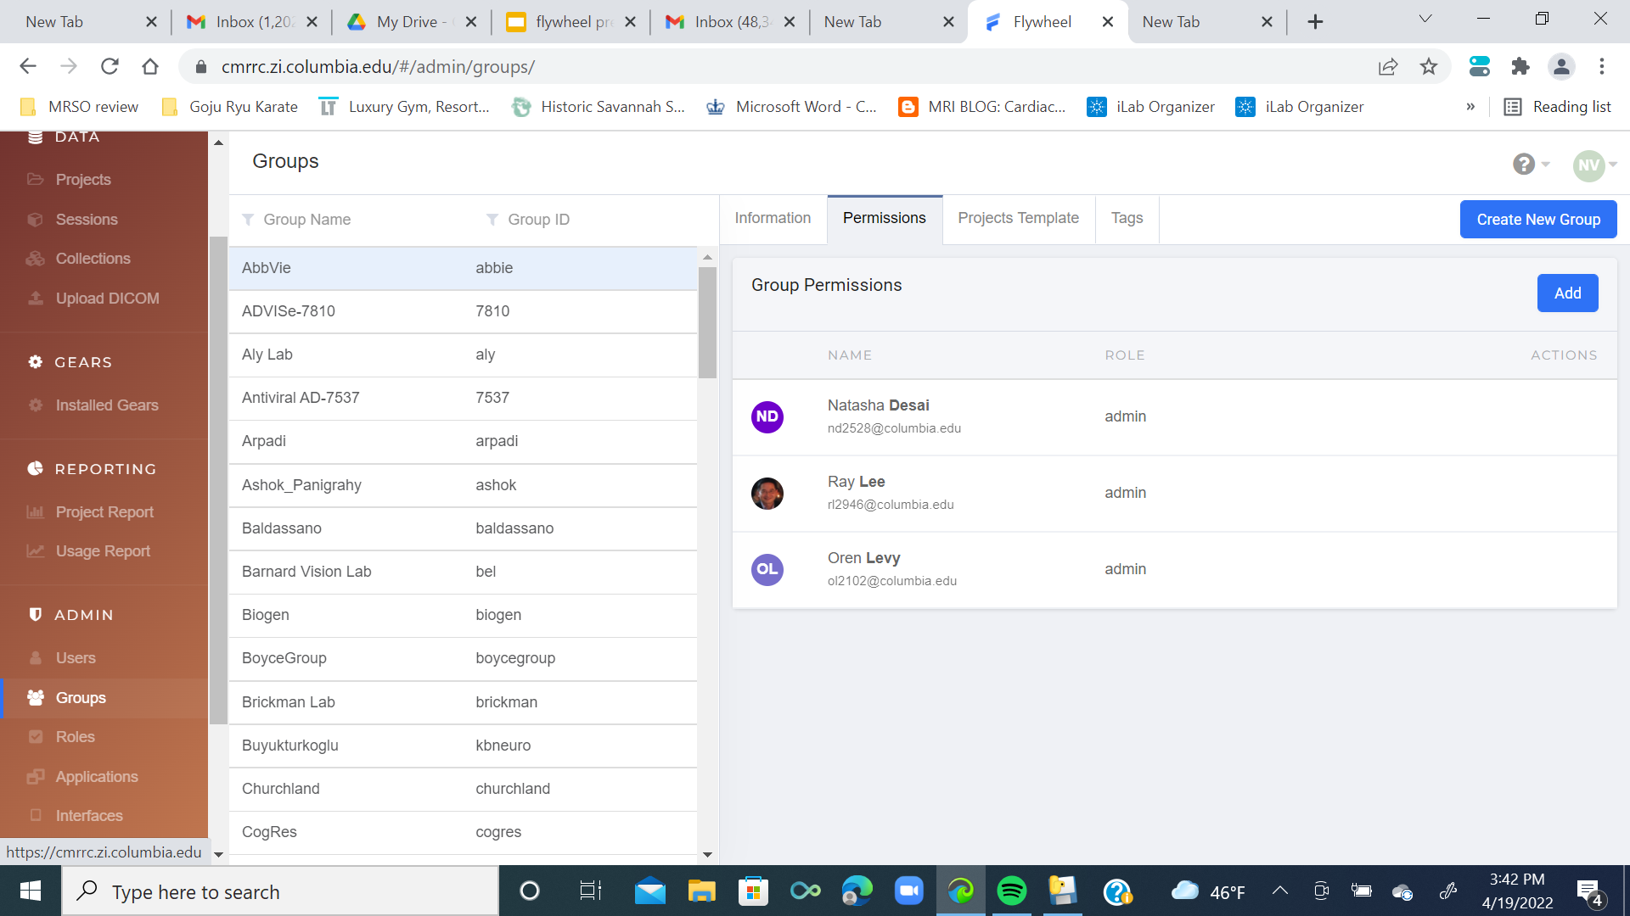
Roles are Users or Administrators
Permissions can be read only, write only, or read write
Notes:
Here’s how to see your permissions.

Slide 17
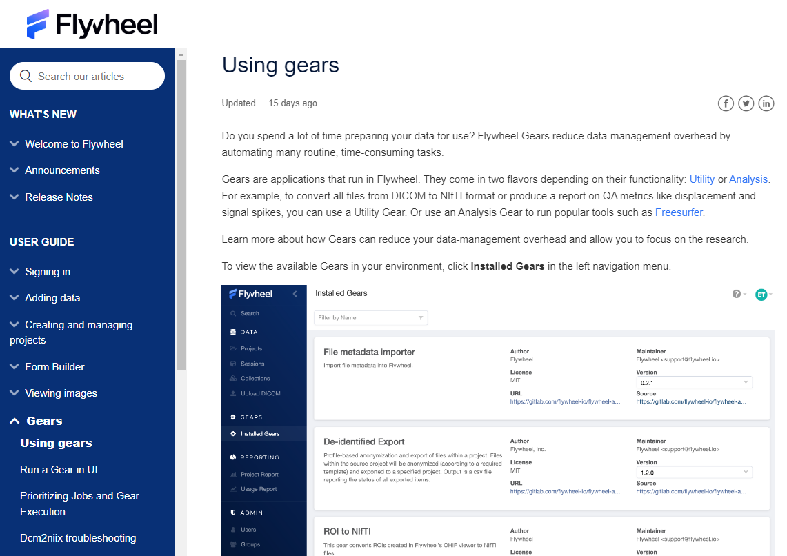
What is a GEAR?
A GEAR in Flywheel is a tool that can be a :
Utility GEAR
Analysis GEAR
Notes:
Flywheel Gears reduce data-management overhead by automating many routine, time-consuming tasks.
Gears are applications that run in Flywheel. They come in two flavors depending on their functionality: Utility or Analysis.
For example, to convert all files from DICOM to NIfTI format or produce a report on QA metrics like displacement and signal spikes, you can use a Utility Gear.
Or use an Analysis Gear to run popular tools such as Freesurfer.

Slide 18
What is a GEAR?
Utility GEAR
Doing something to the data, like convert file types
Analysis GEAR
Doing something with the data, like crunching numbers, signals, etc.
Notes:
Utility example: convert all files from DICOM to NIfTI format or produce a report on QA metrics like displacement and signal spikes
Analysis example: run Freesurfer.

Slide 19
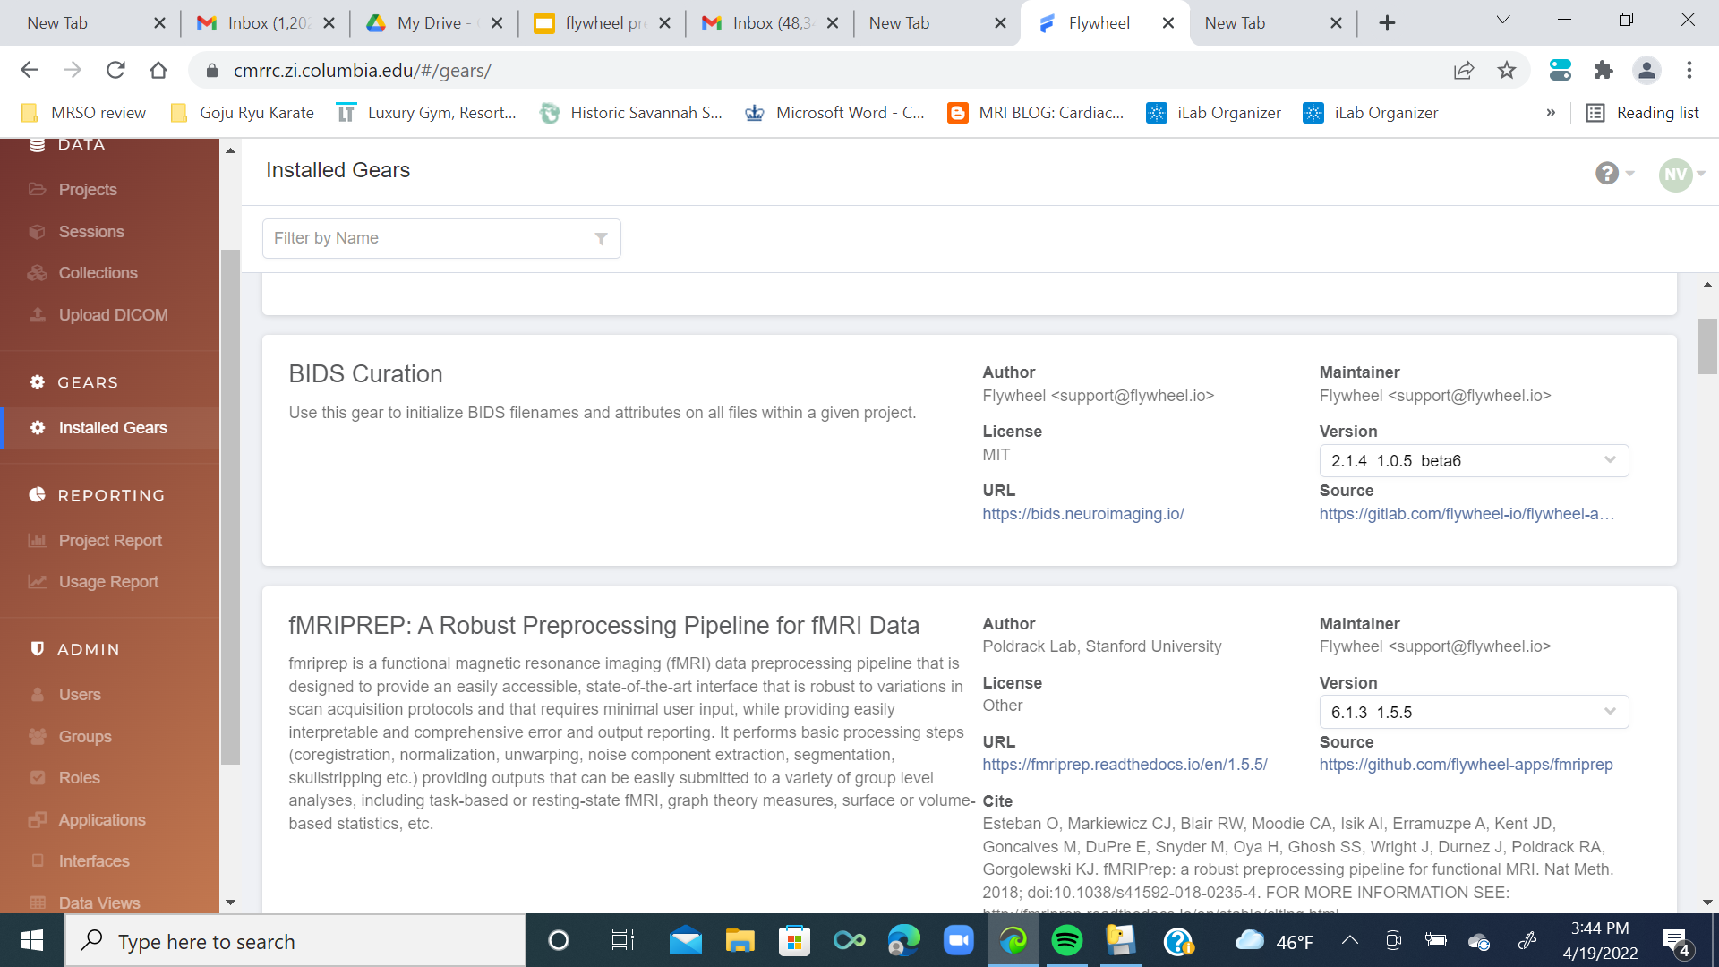
Notes:
Clicking “Installed Gears” in the left-side directory gets you all your options.

Slide 20
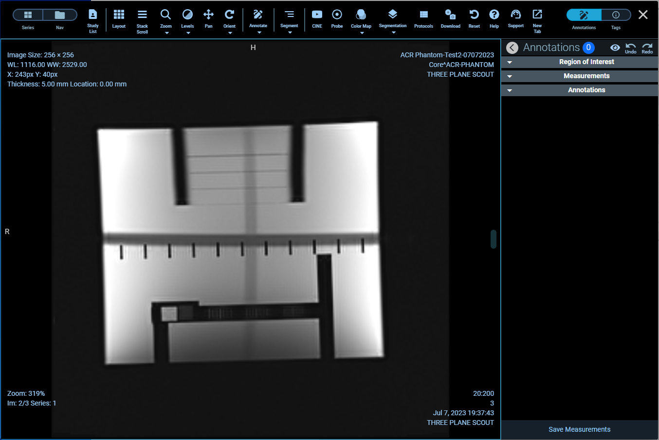
How do I utilize Flywheel
To look at the MR structural images in viewing mode
To create or use a pre-programmed gear to analyze data
To store the data from your MR sessions within a project within a group
To share data with collaborators anywhere in the world
Notes:
Viewing mode example: This is what an phantom from the American College of Radiology (ACR) looks like.

Slide 21
Links & Resources
Logging into Flywheel should bring your right to your data.
Here’s a helpful video that walks through and explains Flywheel features.
Additionally, there's technical documentation that discusses topics from our data hierarchy to BIDS to developing your own gears on Flywheel.
Use this webform to send specific questions to the Flywheel helpdesk. They're generally quite responsive and helpful.
Notes:
Login link: https://cmrrc.zi.columbia.edu
Video: https://www.youtube.com/watch?v=Rzvmxj-JOQE&t=80s Definitely watch this; it goes into more details about the features available in Flywheel.
Technical documentation: https://docs.flywheel.io/hc/en-us
Helpdesk form: https://docs.flywheel.io/hc/en-us/requests/new

